Slide 1
IT 1107 Mathematics for IT
Week 10 - Inverse of a matrix

Slide 2
Inverse of a matrix
For a square matrix A the inverse is written as A⁻¹
Not all square matrices have inverses
A square matrix which has an inverse is called invertible
A square matrix without inverse is called singular matrix
AA⁻¹ = A⁻¹A = I

Slide 3
Note: (AB)⁻¹ = B⁻¹A⁻¹
(A+B)⁻¹ ≠A⁻¹+B⁻¹

Slide 4

Finding inverse for 2x2 matrix
If A = $\left[\begin{matrix}a & b \\ c & d\end{matrix}\right]$ then
A⁻¹=$\frac{1}{\det{A}}\left[\begin{matrix}d & −b \\ −c & a\end{matrix}\right]$
=$\frac{1}{\begin{aligned}ad−bc\end{aligned}}\left[\begin{matrix}d & −b \\ −c & a\end{matrix}\right]$

Slide 5
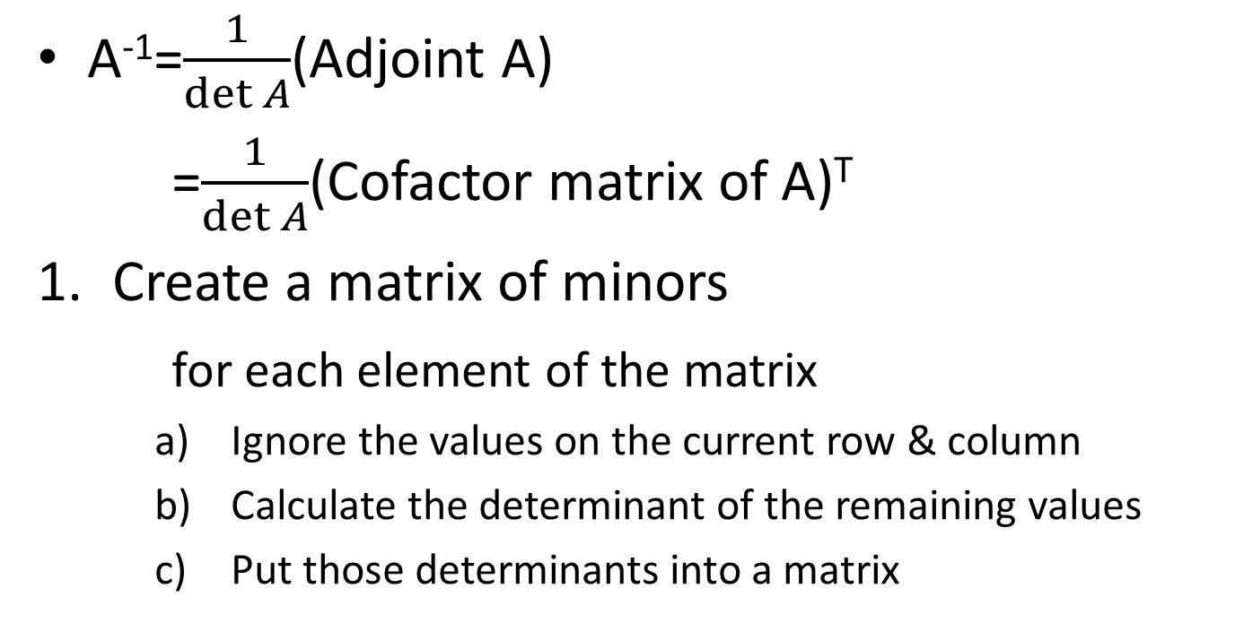
Find inverse of a matrix : Adjoint Method
A⁻¹=$\frac{1}{\det{A}}$(Adjoint A)
=$\frac{1}{\det{A}}$(Cofactor matrix of A)^{T}
Create a matrix of minors
for each element of the matrix
Ignore the values on the current row & column
Calculate the determinant of the remaining values
Put those determinants into a matrix

Slide 6
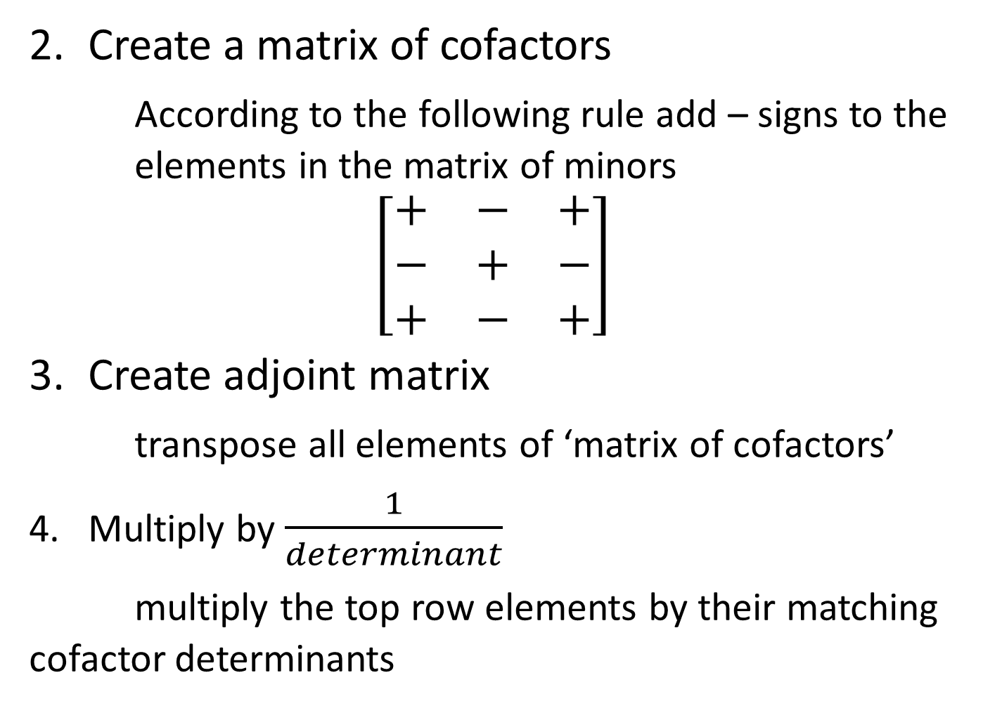
Create a matrix of cofactors
According to the following rule add – signs to the elements in the matrix of minors
$$\left[\begin{matrix}+ & − & + \\ − & + & − \\ + & − & +\end{matrix}\right]$$
Create adjoint matrix
transpose all elements of ‘matrix of cofactors’
Multiply by $\frac{1}{determinant}$
multiply the top row elements by their matching cofactor determinants

Slide 7
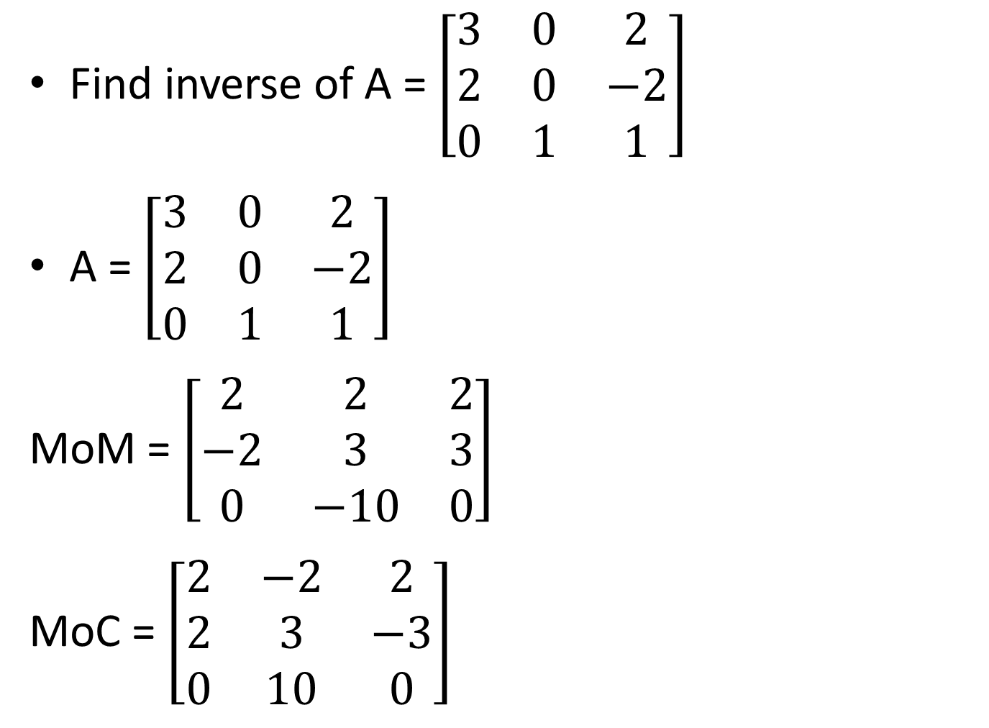
Find inverse of A = $\left[\begin{matrix}3 & 0 & 2 \\ 2 & 0 & −2 \\ 0 & 1 & 1\end{matrix}\right]$
A = $\left[\begin{matrix}3 & 0 & 2 \\ 2 & 0 & −2 \\ 0 & 1 & 1\end{matrix}\right]$
MoM = $\left[\begin{matrix}2 & 2 & 2 \\ −2 & 3 & 3 \\ 0 & −10 & 0\end{matrix}\right]$
MoC = $\left[\begin{matrix}2 & −2 & 2 \\ 2 & 3 & −3 \\ 0 & 10 & 0\end{matrix}\right]$

Slide 8
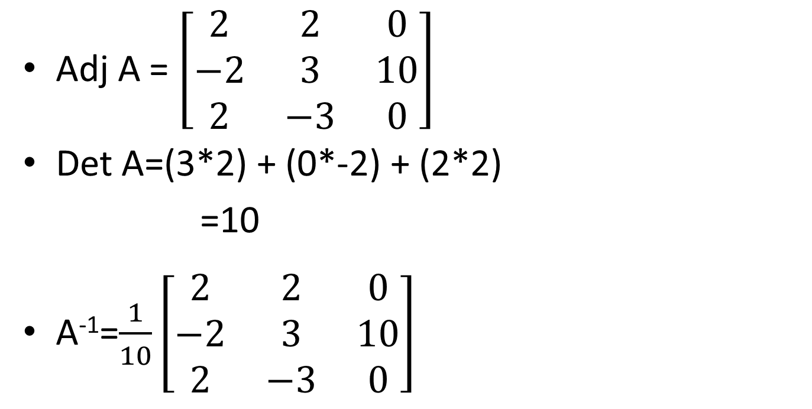
Adj A = $\left[\begin{matrix}2 & 2 & 0 \\ −2 & 3 & 10 \\ 2 & −3 & 0\end{matrix}\right]$
Det A=(3*2) + (0*-2) + (2*2)
=10
A⁻¹=$\frac{1}{10}\left[\begin{matrix}2 & 2 & 0 \\ −2 & 3 & 10 \\ 2 & −3 & 0\end{matrix}\right]$

